Slide 1

Chapter 1 The Information Systems Strategy Triangle
Managing and Using Information Systems: A Strategic Approach
by Keri Pearlson & Carol Saunders

Slide 2
Slide 4;10;16 et 22; Primordial à maîtriser
Faire exercice page 10, 16, et 19
Important lire le cas de Google page 18

Slide 3
The Impact of IS
Companies are out of alignment when their business strategy is not supported by their IS.
The Information Systems Strategy Triangle is a simple framework for understanding the impact of IS on organizations and proper alignment.
This business strategy drives both Organizational and Information strategy ????

Slide 4
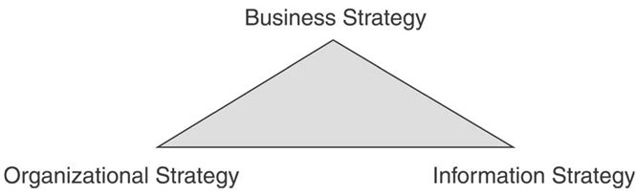
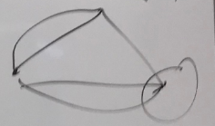
Figure 1.1 The Information Systems Strategy Triangle

Slide 5
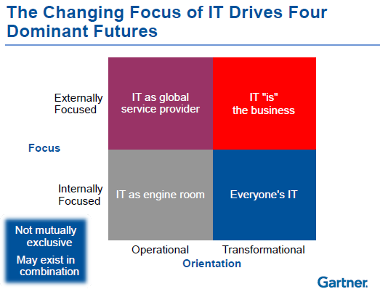

Slide 6
Think About IT
What is a business strategy?
Which factors influences a business strategy?
How does a business change its strategy without losing balance or becoming out of alignment?
Are there specific events that induce a business to change its strategies? What are they?

Slide 7
Strategy
A strategy is a coordinated set of actions to fulfill objectives, purposes and goals.
Strategy starts with a mission.
Figure 1.2 shows some example mission statements.
A business strategy is a plan articulating where a business seeks to go and how it expects to get there.
There are several “strategies” worth examining.

Slide 8
Company | Statement
IBM | At IBM, we strive to lead in the creation, development and manufacture of the industry's most advanced information technologies, including computer systems, software, networking systems, storage devices and microelectronics. We translate these advanced technologies into value for our customers through our professional solutions and services businesses worldwide.
Dell | Dell's mission is to be the most successful computer company in the world at delivering the best customer experience in markets we serve.
Apple | Apple ignited the personal computer revolution in the 1970s with the Apple II and reinvented the personal computer in the 1980s with the Macintosh. Apple is committed to bringing the best personal computing experience to students, educators, creative professionals and consumers around the world through its innovative hardware, software and Internet offerings.
Figure 1.2 – Mission statements of computer companies

Slide 9
Generic Strategies Framework
Michael Porter describes how businesses can build a sustainable competitive advantage.
He identified three primary strategies for achieving competitive advantage:
Cost leadership – lowest-cost producer.
Differentiation – product is unique.
Focus – limited scope.

Slide 10
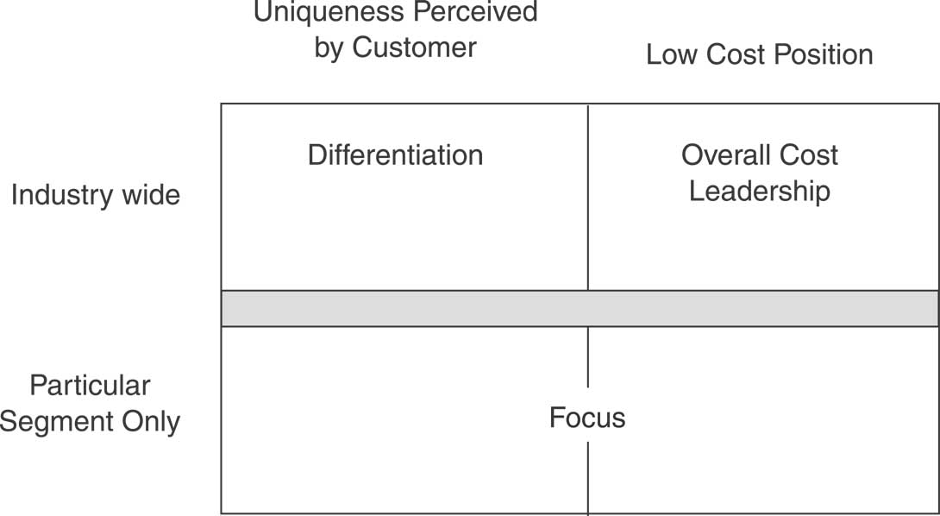
Exemple application BI
Exemple application BI
Exemple application BI
Figure 1.3 Three strategies for achieving competitive advantage.

Slide 11
Summary
The Information Systems Strategy Triangle shows that business strategy always drives organizational and information strategies. ???
Business strategy drives organizational and IS strategy.
Includes models from Porter and D’Aveni.
Organizational strategy must complement business strategy.
Models are the business diamond and managerial levers.
IS strategy must complement business strategy.
When IS supports business goals the business the business appears to be working well.
Strategic Relationships.
Organizational strategy and information strategy must complement each other.
They must support, not hinder each other.
If change is made to one area the others must be examined to ensure balance.

Slide 12
Chapter 2 Strategic Use of Information Resources
Managing and Using Information Systems: A Strategic Approach
by Keri Pearlson & Carol Saunders

Slide 13
HOW CAN INFORMATION RESOURCES BE USED STRATEGICALLY?

Slide 14
The Strategic Landscape
Managers must take multiple view of the strategic landscape, such as:
First view - Porter’s five competitive forces model.
Second view - Porter’s value chain.
Third view – focuses on the types of IS resources needed (Resource Based View).

Slide 15
Using Information Resources to Influence Competitive Forces
Porter’s five forces model show the major forces that shape the competitive environment of the firm.
Threat of New Entrants: new firms that may enter a companies market.
Bargaining Power of Buyers: the ability of buyers to use their market power to decrease a firm’s competitive position
Bargaining Power of Suppliers: the ability suppliers of the inputs of a product or service to lower a firm’s competitive position
Threat of Substitutes: providers of equivalent or superior alternative products
Industry Competitors: current competitors for the same product.
Figure 2.3 and 2.4 show this model in detail.

Slide 16
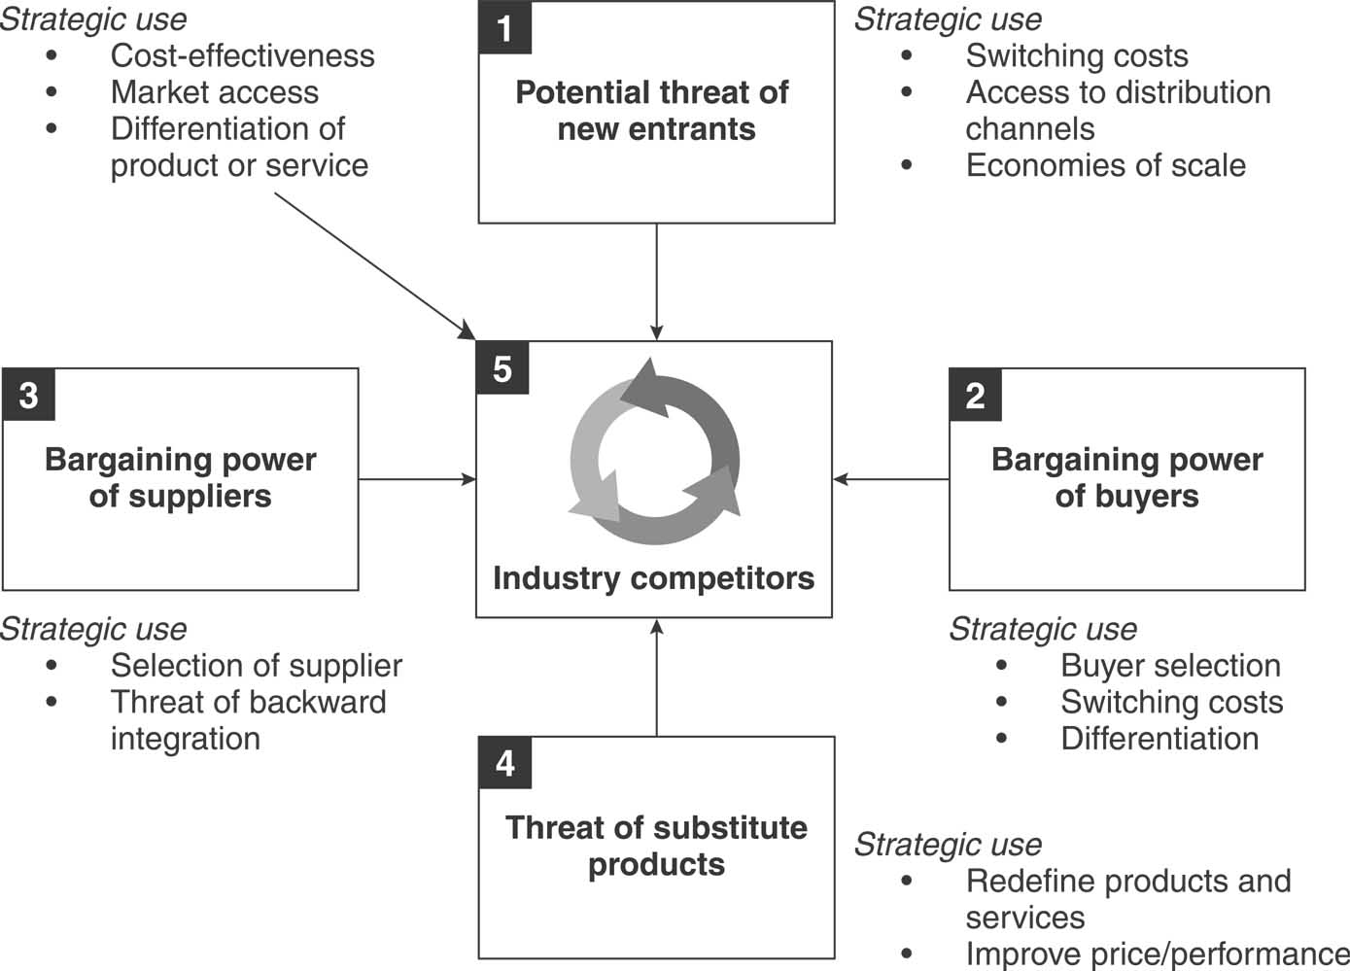
Exemple application BI
Figure 2.3 Five competitive forces with potential
strategic use of information resources.

Slide 17
Activity | Zara’s Value Chain
Primary Activities
Inbound Logistics | IT-enabled Just-in-Time (JIT) strategy results in inventory being received when needed. Most dyes are purchased from its own subsidiaries to better support JIT strategy and reduce costs.
Operations | Information systems support decisions about the fabric, cut and price points. Cloth is ironed and products are packed on hangers so they don’t need ironing when they arrive at stores. Price tags are already on the products. Zara produces 60% of its merchandise in-house. Fabric is cut and dyed by robots in 23 highly automated Spanish factories.
Outbound Logistics | Clothes move on miles of automated conveyor belts at distribution centers and reach stores within 48 hours.
Marketing and Sales | Limited inventory allows low percentage of unsold inventory (10%); POS at stores linked to headquarters to track how items are selling; Customers ask for what they want and this information is transmitted daily from stores to designers over handheld computers.
Service | No focus on service on products
SUPPORT ACTIVITIES
Organization | IT supports tightly-knit collaboration among designers, store managers, market specialists, production managers and production planners.
Human Resources
Technology | Technology is integrated to support all primary activities. Zara’s IT staff works with vendor to develop automated conveyor to support distribution activities.
Purchasing | Vertical integration reduces amount of purchasing needed.
Figure 2.7 Application of Value Chain Model

Slide 18
Competitive Force | IT Influence on Competitive Force
Threat of New Entrants | Zara’s IT supports its tightly-knit group of designers, market specialists, production managers and production planners. New entrants are unlikely to provide IT to support relationships that have been built over time. Further it has a rich information repository about customers that would be hard to replicate.
Bargaining Power of Buyers | With its constant infusion of new products, buyers are drawn to Zara stores. Zara boasts more than 11,000 new designs a year, whereas competitors typically offer only 2,000 – 4,000. Further, because of the low inventory that the Zara stores stock, the regulars buy products they like when they see them because they are likely to be gone the next time they visit the store. More recently Zara has employed laser technology to measure 10,000 women volunteers so that it can add the measurements of ‘real’ customers into its information repositories. This means that the new products will be more likely to fit Zara customers.
Bargaining Power of Suppliers | Its computer-controlled cutting machine cuts up to 1000 layers at a time. It then sends the cut materials to suppliers who sew the pieces together. The suppliers’ work is relatively simple and many suppliers can do the sewing. Thus, the pool of suppliers is expanded and Zara has greater flexibility in choosing the sewing companies. Further, because Zara dyes 50% of the fabric in its plant, it is less dependent on suppliers and can respond more quickly to mid-season changes in customer color preferences.
Threat of Substitute Products | Industry competitors long marketed the desire of durable, classic lines. Zara forces on meeting customer preferences for trendy, low-cost fashion. It has the highest sales per square foot of any of its competitors. It does so with virtually no advertising and only 10% of stock is unsold. It keeps its inventory levels very low and offers new products at an amazing pace for the industry (i.e., 15 days from idea to shelves). Zara has extremely efficient manufacturing and distribution operations.
Industrial Competitors | Zara offers extremely fashionable lines that are only expected to last for approximately 10 wears. It offers trendy, appealing apparel at a hard-to-beat price.
Figure 2.4 Application of five competitive forces model for Zara.

Slide 19
Competitive Force | IT Influence on Competitive Force (BI drivers)
Threat of New Entrants | .
Bargaining Power of Buyers
Bargaining Power of Suppliers
Threat of Substitute Products
Industrial Competitors
Figure 2.4 Application of five competitive forces model for Zara.

Slide 20
Porter’s Value Chain Model
Value chain model addresses the activities that create, deliver, and support a company’s product or service (see Figure 2.5).
Two broad categories:
Primary activities – relate directly to the value created in a product or service.
Support activities – make it possible for the primary activities to exist and remain coordinated.

Slide 21
Altering the Value Chain
The Value Chain model suggest that competition can come from two sources:
Lowering the cost to perform an activity and
Adding value to a product or service so buyers will be willing to pay more.
Lowering costs only achieves competitive advantage if the firm possesses information on the competitor’s costs
Adding value is a strategic advantage if a firm possesses accurate information regarding its customer such as: which products are valued? Where can improvements be made?

Slide 22
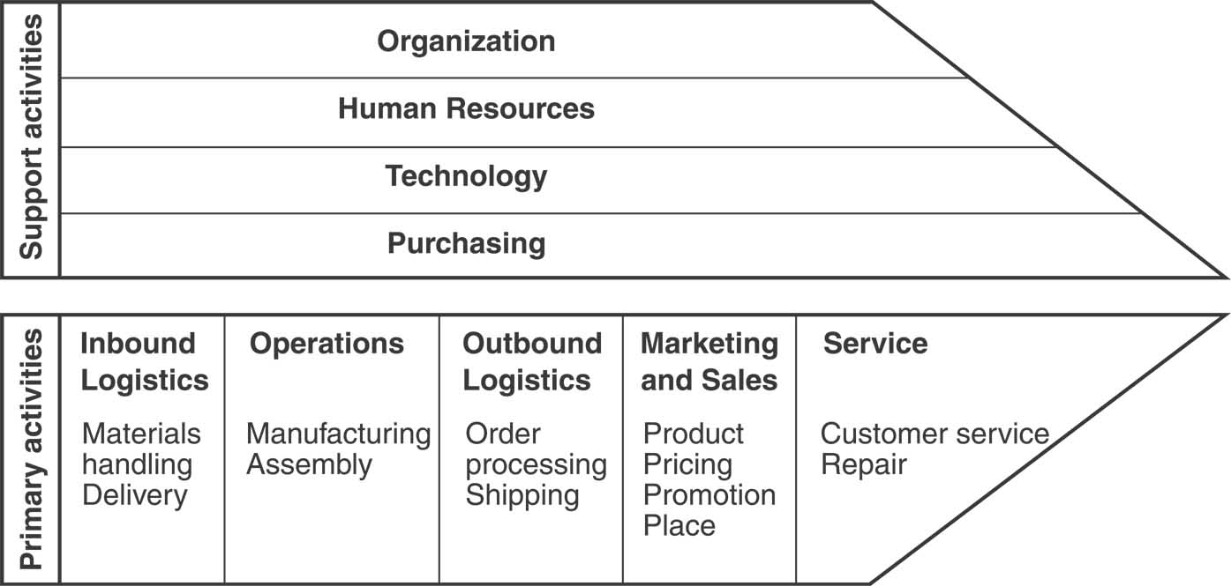
Exemple application BI
Figure 2.5 Value chain of the firm.

Slide 23
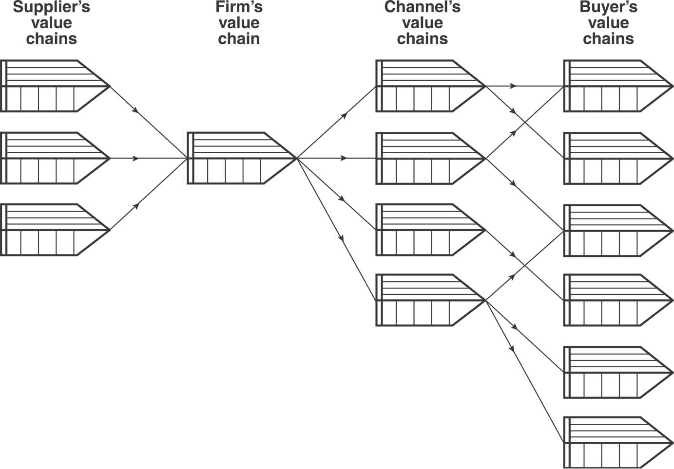
Nikes
Exemple application BI
Figure 2.6 The value system: interconnecting relationships between organizations.

Slide 24
Real World Examples
The Spanish manufacturer Zara has a simple business model that provides a significant strategic advantage.
Their system links demand to manufacturing and manufacturing to distribution.
Customers visit up to 17 times per year to check on new items that may have arrived.
Since products are limited customers will immediately purchase products they like.
Loyal and satisfied customer base.

Slide 25
Activity | Zara’s Value Chain
Primary Activities
Inbound Logistics | IT-enabled Just-in-Time (JIT) strategy results in inventory being received when needed. Most dyes are purchased from its own subsidiaries to better support JIT strategy and reduce costs.
Operations | Information systems support decisions about the fabric, cut and price points. Cloth is ironed and products are packed on hangers so they don’t need ironing when they arrive at stores. Price tags are already on the products. Zara produces 60% of its merchandise in-house. Fabric is cut and dyed by robots in 23 highly automated Spanish factories.
Outbound Logistics | Clothes move on miles of automated conveyor belts at distribution centers and reach stores within 48 hours.
Marketing and Sales | Limited inventory allows low percentage of unsold inventory (10%); POS at stores linked to headquarters to track how items are selling; Customers ask for what they want and this information is transmitted daily from stores to designers over handheld computers.
Service | No focus on service on products
SUPPORT ACTIVITIES
Organization | IT supports tightly-knit collaboration among designers, store managers, market specialists, production managers and production planners.
Human Resources
Technology | Technology is integrated to support all primary activities. Zara’s IT staff works with vendor to develop automated conveyor to support distribution activities.
Purchasing | Vertical integration reduces amount of purchasing needed.
Figure 2.7 Application of Value Chain Model

Slide 26
Summary
Using IS for strategic advantage requires more than just knowing the technology.
Remember that not just the local competition is a factor in success but the 5 competitive forces model reminds us of other issues.
Value chain analysis show us how IS add value to the primary activity of a business.
Know the risks associated with using IS to gain strategic advantage.

Slide 27
Case Study 1-2: Google
1. How is Google’s mission statement related to its business strategy?
Ans: Google’s primary goal is to organize the world’s information and make it universally accessible and useful (mission statement). Google continues to take risks and expand into new markets to further its reach into the information world. It takes advantage of new avenues to expand its market share by making information freely available on its Intranet, and by willing to take risks by investing in speculative and strange projects if they see a large potential payoff.
2. How does Google’s information systems strategy support its business strategy?
Ans: Through openness and innovation. It permits users to download their own software, maintain official and unofficial blogs, and buys and makes software to suit the needs of the business. IT encourages innovation by allowing employees to spend 20% of their time on a project of their own choosing. This “flexible” IT structure supports the innovation and creativity that its business strategy espouses.
3. How does Google’s organizational strategy supports its business strategy?
Ans: Google has a culture of innovation and creativity. However, it still provides a level of structure when making decisions. Specifically, Google’s mission statement relates to its business strategy by making data on all ongoing projects and systems available to all of its employees through its corporate Intranet. Any employee can see what is transpiring in other areas and can lend a hand through Google’s “free day” policy and other open work-environment strategies.
4. Which of Porter’s three generic strategies does Google appear to be using based upon this case? Provide a rationale for your response.
Ans: Differentiation, though one may argue that cost leadership is also utilized with its very reasonable ad costs. However, though the use of its innovative processes, and unique business model, Google has differentiated itself from its competitors by keeping a clean and simple interface (which most of the other search engines have emulated), and by continuing to invest in its employees, to provide innovation on a large scale.

Slide 28
Chapter 1: The Information Systems Strategy Triangle.
Brief Overview of Business Strategy Frameworks.
Brief Overview of Organizational Strategies.
Brief Overview of Information Systems Strategy.
Case Study 1-1: Roche’s New Scientific Method.
Case Study 1-2: Google.
Chapter 2: Strategic Use of Information Resources.
Evolution of Information Resources.
Information Resources as Strategic Tools.
How Can Information Resources Be Used Strategically?
Strategic Alliances.
Risks.
Chapter 3: Organizational Impacts of Information Systems Use.
Information Technology and Organizational Design.
Information Technology and Management Control Systems.
Information Technology and Culture.
Chapter 4: Information Technology and the Design of Work.
Work Design Framework.
How Information Technology Supports Communication and Collaboration.
How Information Technology Changes the Nature of Work.
How Information Technology Changes Where Work Is Done and Who Does It.
Virtual Teams.
Case Study 4-2: Virtually There?
Chapter 5: Information Technology and Changing Business Processes.
Silo Perspective Versus Business Process Perspective.
The Tools for Change.
Shared Services.
Enterprise Systems.
Integrated Supply Chains.
Chapter 6: Architecture and Infrastructure.
From Vision to Implementation.
The Leap from Strategy to Architecture to Infrastructure.
Architectural Principles.
Enterprise Architecture.
Other Managerial Considerations.
From Strategy to Architecture to Infrastructure: An Example.
Food for Thought: Cloud Computing.
Case Study 6-2: Johnson & Johnson's Enterprise Architecture.
Chapter 7: Information Systems Sourcing.
Sourcing Decision Cycle Framework.
Insourcing.
Outsourcing.
Outsourcing Abroad.
Backsourcing.
Outsourcing Models.
Case Study 7-2: Overseas Outsourcing of Medical Transcribing.
Chapter 8: Governance of the Information Systems Organization.
Understanding the IS Organization.
What a Manager Can Expect from the IS Organization.
What the IS Organization Does Not Do.
IT Governance.
Food for Thought: CIO Leadership Profiles.
Case Study 8-1: IT Governance at UPS.
Chapter 9: Using Information Ethically.
Normative Theories of Business Ethics.
Control of Information.
Security and Controls.
IT Governance and Security.
Chapter 10: Funding IT.
Funding IT Resources.
How Much Does IT Cost?
Building a Business Case.
IT Portfolio Management.
Valuing IT Investments.
Chapter 11: Project Management.
What Defines a Project?
What is Project Management?
Project Elements.
IT Projects.
IT Project Development Methodologies.
Managerial Influences.
Managing Project Risk.
The PMO.
Chapter 12: Managing Business Knowledge.
Knowledge Management.
Data, Information, and Knowledge.
From Managing Knowledge to Business Intelligence

